Slide 1
Campus: Coupon Code Log-In

Slide 2
Guide for coupon code
Step 1a
Log in via new MyKarger account
Step 2
Enter the coupon code
Step 3
Access courses
Step 1b
Log in via existing MyKarger account

Slide 3
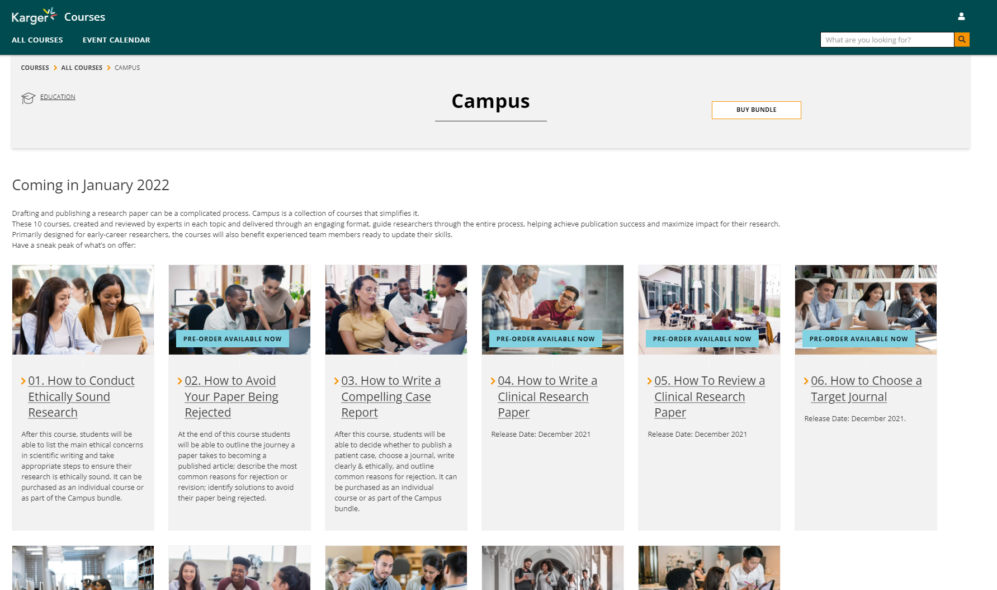
Step 1
Go to www.karger.com/campus and click ‘buy bundle’. The coupon code works only via the ‘buy bundle’ button!
Coupon code does not work via a single course! Click on ‘buy bundle’ at the top of the page.

Slide 4
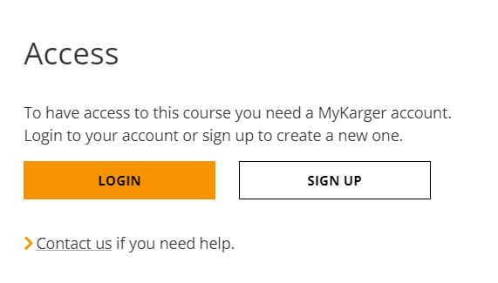
Step 1a
Create a MyKarger account by clicking ‘sign up’

Slide 5
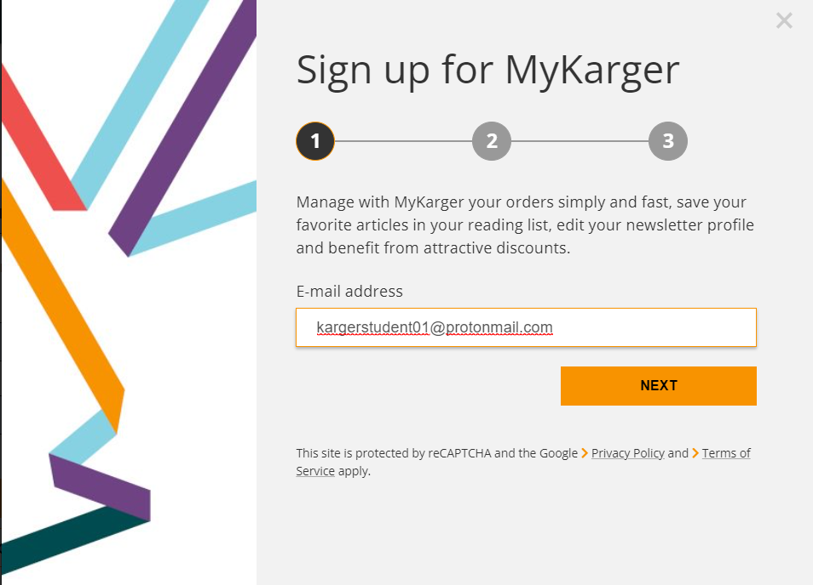
Step 1a
Enter your email address

Slide 6
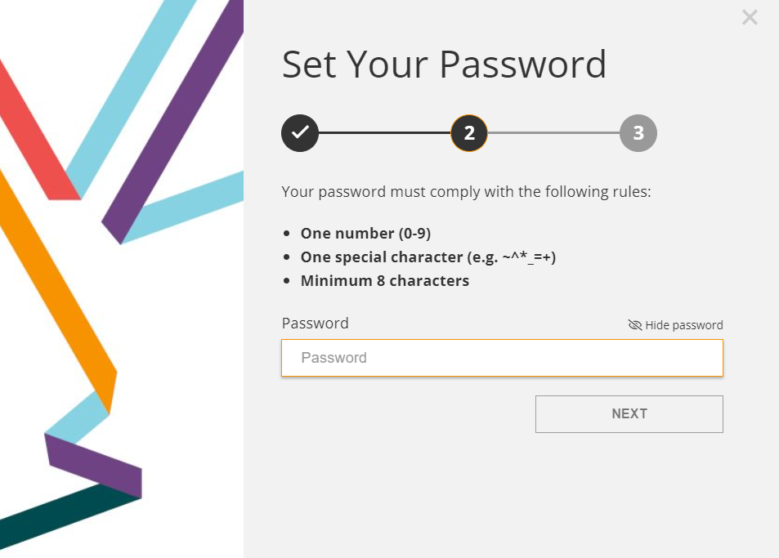
Step 1a
Choose a password

Slide 7
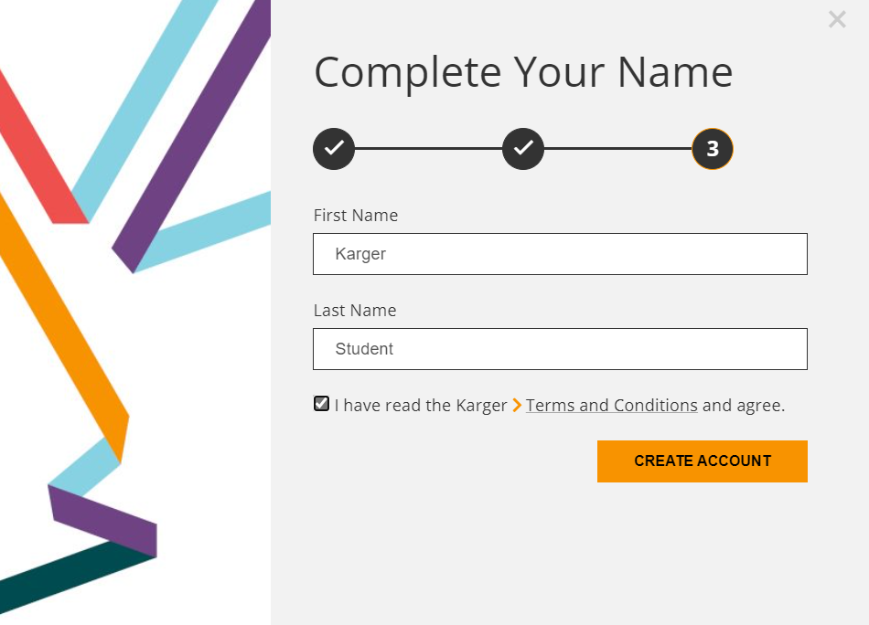
Step 1a
Enter your name and agree to the ‘terms and conditions’

Slide 8
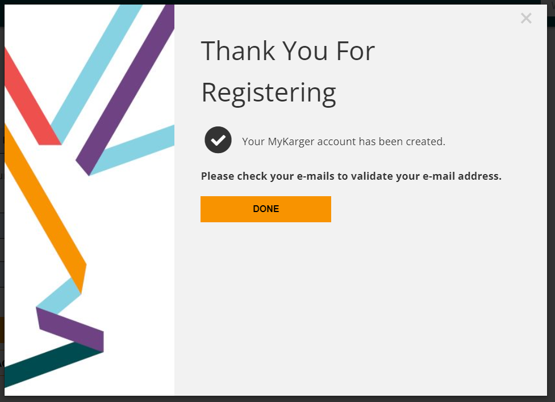
Step 1a
Click ‘done’

Slide 9
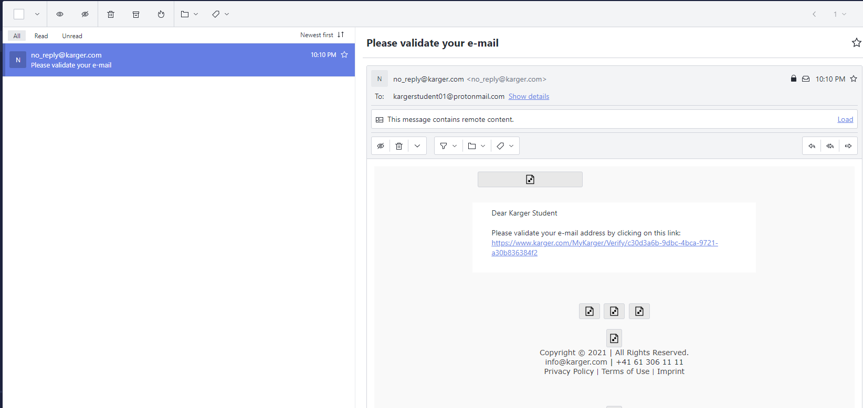
Step 1a
Click on link in email sent to your email address to validate

Slide 10
Guide for coupon code
Step 1a
Log in via new MyKarger account
Step 2
Enter the coupon code
Step 3
Access courses
Step 1b
Log in via existing MyKarger account

Slide 11
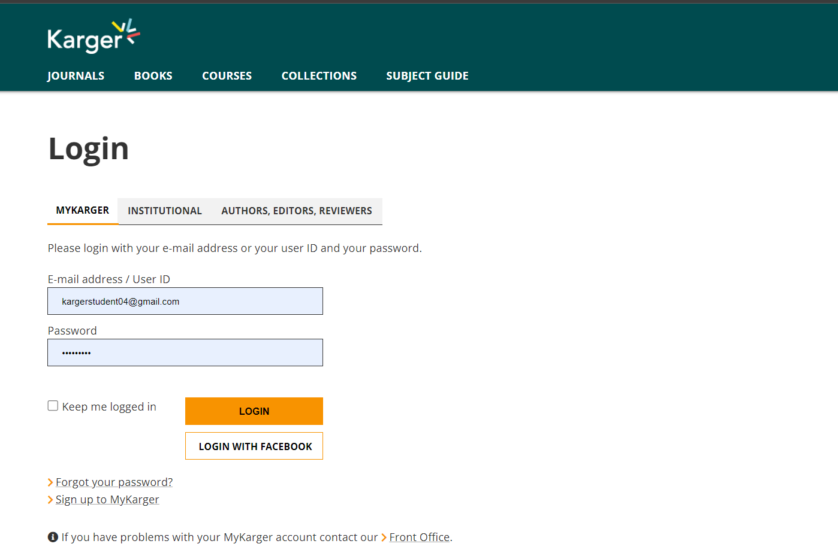
Step 1b
Enter your MyKarger log-in details

Slide 12
Guide for coupon code
Step 1a
Log in via new MyKarger account
Step 2
Enter the coupon code
Step 3
Access courses
Step 1b
Log in via existing MyKarger account

Slide 13
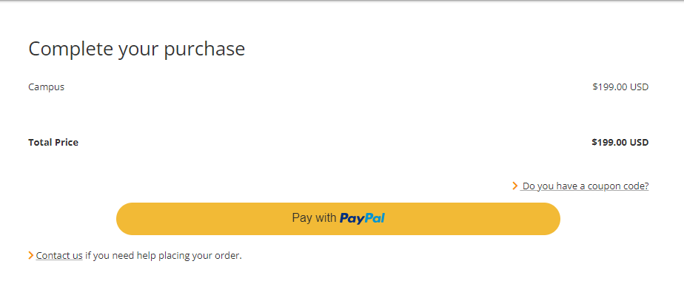
Step 2
Click on ‘do you have a coupon code?’

Slide 14
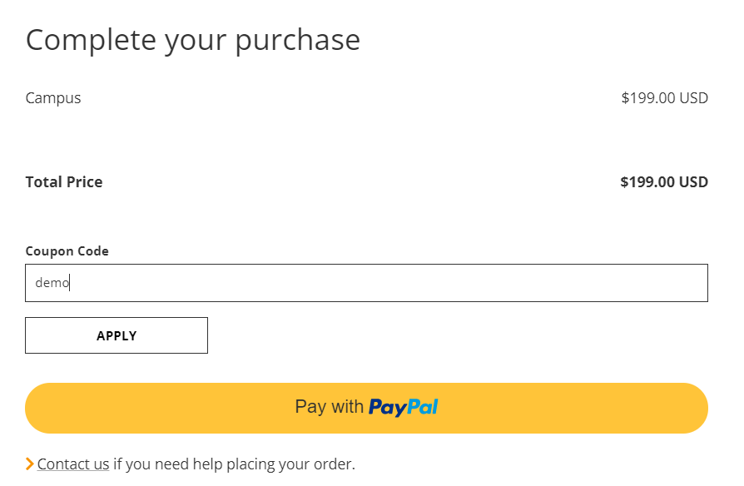
Step 2
Enter coupon code, value is deducted, click on ‘enroll now’

Slide 15
Step 2
Choose the course you want to start

Slide 16
Guide for coupon code
Step 1a
Log in via new MyKarger account
Step 2
Enter the coupon code
Step 3
Access courses
Step 1b
Log in via existing MyKarger account

Slide 17
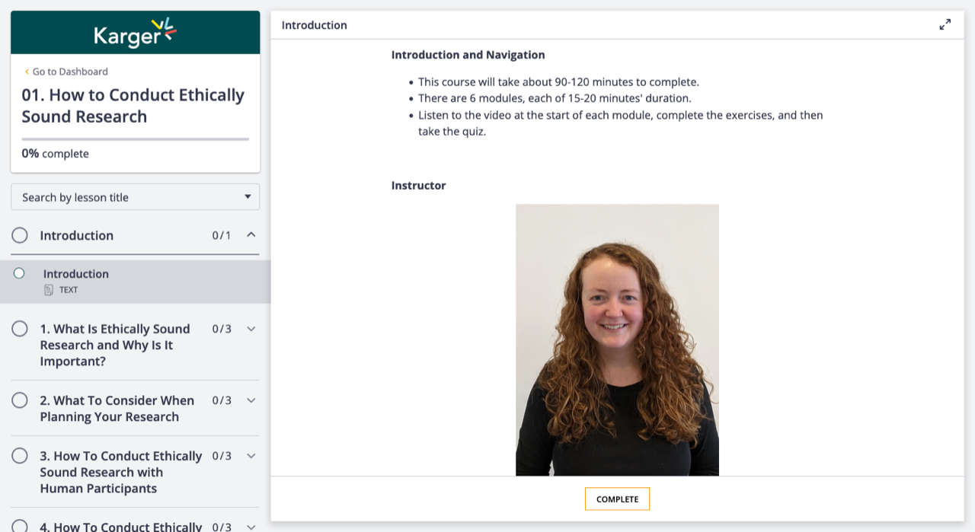
Step 3
Access to all Campus courses on dashboard
Click on ‘go to dashboard’ to see all courses

Slide 18
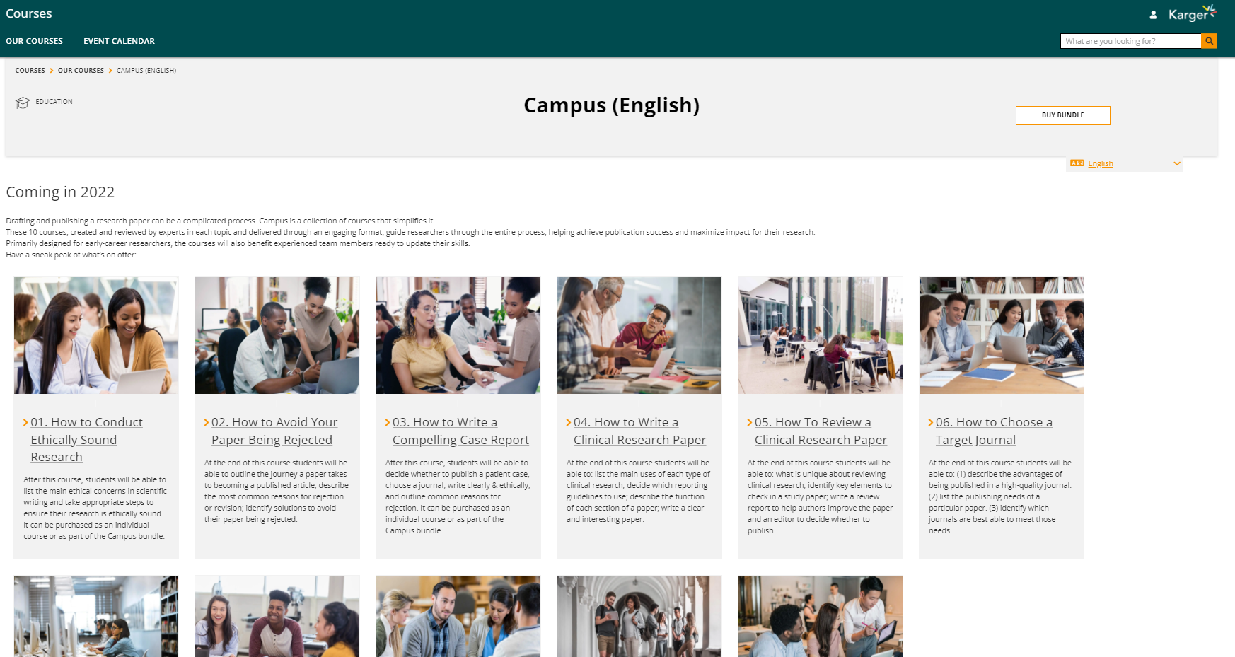
Step 3
Access to all Campus courses on dashboard

Slide 19
If you have any log-in or access issues please contact us for assistance.

